Slide 1
Web Traffic
Time Series Forecasting
Forecast future traffic to Wikipedia pages
Presented by Rida Jawwad

Slide 2
OVERVIEW
Data Analysis
Training Models
2
4
1
3
5
Understanding Data &
Data Pre-processing
Feature Engineering
Optimization

Slide 3
Understanding Data & Data Pre-Processing

Slide 4

PROBLEM AND GOAL
This case study focuses on predicting future traffic for multiple Wikipedia pages.
The data contains 145k rows and 550 columns. In columns we have 1 page column and 549 views columns by days
Each time series contains daily traffic on Wikipedia page for a total of 549 days from 2015-07-01 to 2016-12-31
We have a total of 145k time series which means we have data for 145k pages.
Our goal is to work on 1 time series, build 3 model on it and predict future traffic on that page for 56 days from 2016-11-06 to 2016-12-31.

Slide 5
Dealing with Missing Values
Unfortunately, the data does not distinguish between traffic values of zero and missing values.
A missing value may mean that the traffic was zero or that the data is not available for that day.
There are about 8% missing values in the data, which is not trivial.
I’ve replaced all the missing values with 0.
Data
Complexity
Melting the Data
The data was in wide format
I changed it into long format

Slide 6
Data
Analysis

Slide 7
01
Explored Page column
06
Month with most visits on an average
I have a page column in my data which contains different information about article (Article name, Language, Project, Access, Agent). I separated those things in different columns to do further analysis
Found out that May is the answer to this question
02
Top 10 pages with most visits
07
Day of the week with most visits on an average
From 145k articles, I extracted top 10 pages which has the most views
Sunday has the most number of visitors on an average but all of them are pretty close and don’t have much difference.
03
Views by Project, Access, Agent
Made graphs to visualize the number of views of all time series according to project name, access and agent
08
Does holiday season affects the number of visitors?
04
Views by Language
During the holiday season, Wikipedia pages has less traffic in comparison to other months of the year
We have articles of 7 languages. Visualized views by 7 different languages. Visualized sudden increase in visits in English and Russian pages, extracted top 10 pages from each language

Slide 8
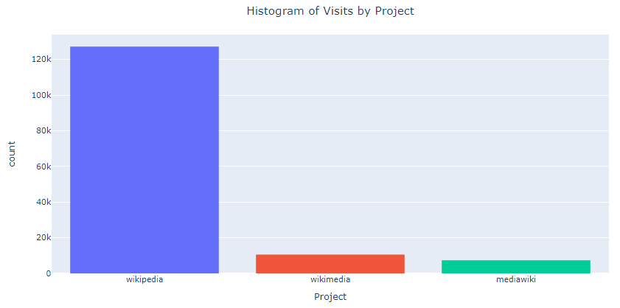
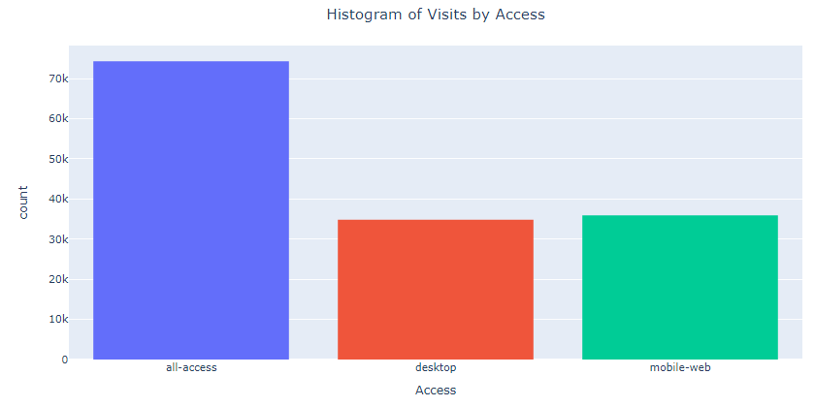
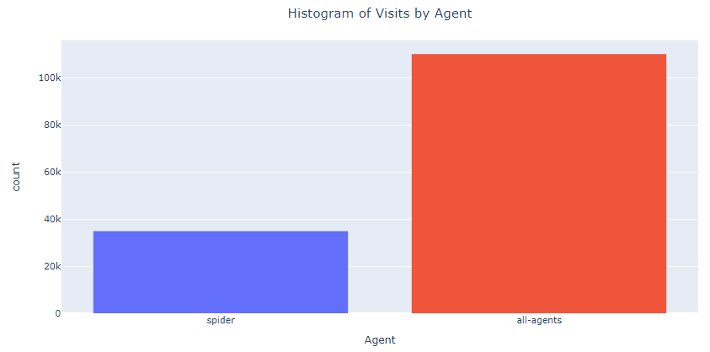
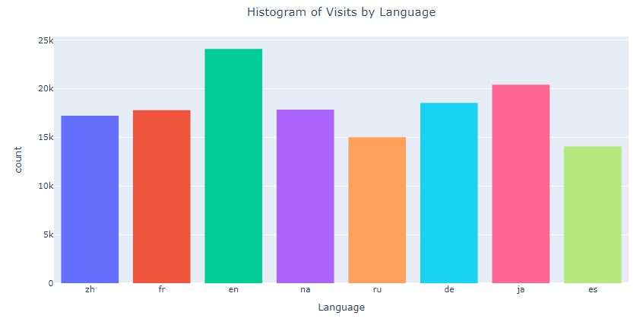

Slide 9
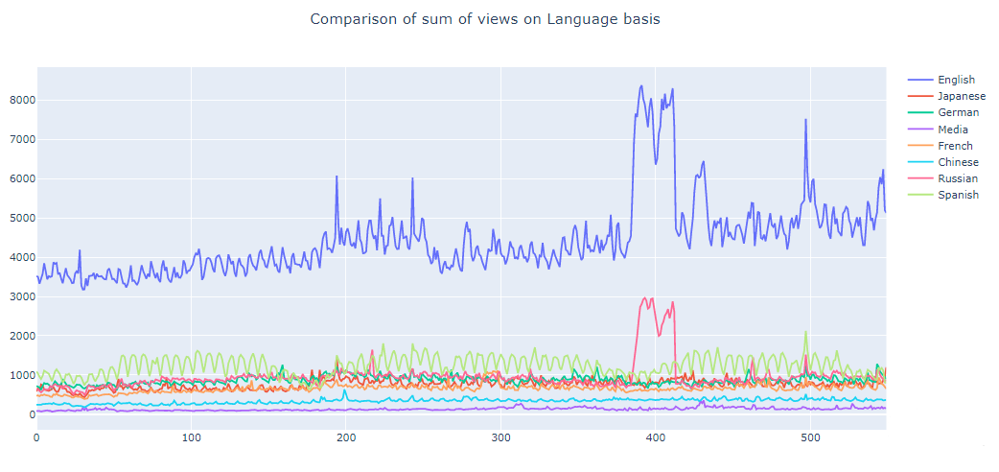

Slide 10
Feature
Engineering

Slide 11
For now, I am working on only one time series data i.e. a Spanish article which has the most views among all Spanish pages
01
Seasonal Decomposition
Time series decomposition involves thinking of a series as a combination of level, trend, seasonality and noise components.
ADF Test
02
You Augmented Dickey Fuller test is a common statistical test used to test whether a given time series is stationary or not. After doing this test, I found out that my data is non-stationary
03
Moving Average method for stationarity
To make the data stationary, I used moving average method.
ACF and PACF plots
04
Autocorrelation is the correlation of a time series with the same time series lagged. We use these plots for hyper parameters of Arima model

Slide 12
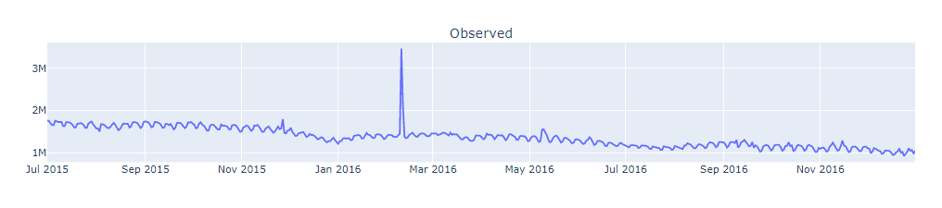
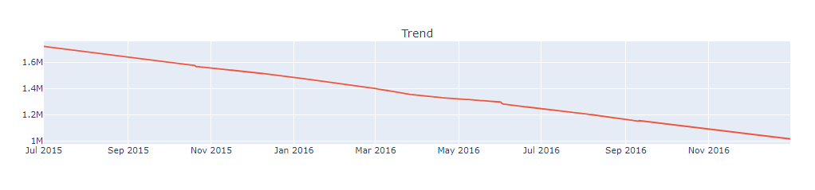
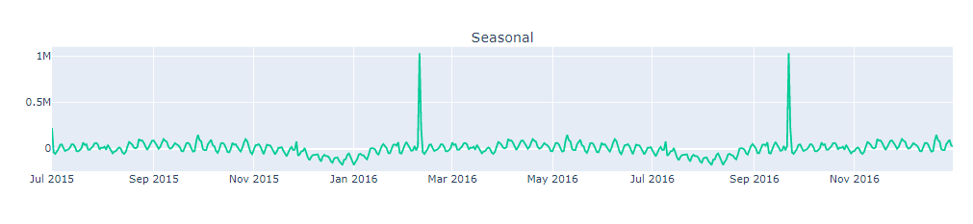
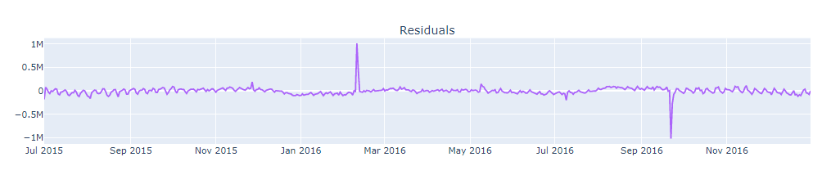
SEASONAL DECOMPOSITION

Slide 13
Model Training and Optimization

Slide 14
Model Comparison
Model Optimization
Model
Evaluation
Lastly I created a general function for seasonal decomposition and model comparison (with MAPE and comparison plot)
Model Training
I did hypermeter tuning
to improve performance of my models
Data Splitting
I used MAPE (Evaluation Metric)
for the evaluation of my models
Then I applied Arima, ETS and FB Prophet models on training set
First of all, I split the data into train and test datasets. Training data has 90% of the data whereas Test data has 10% of the data

Slide 15
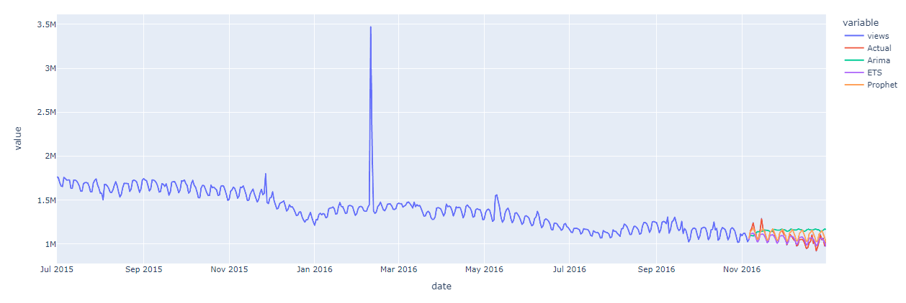
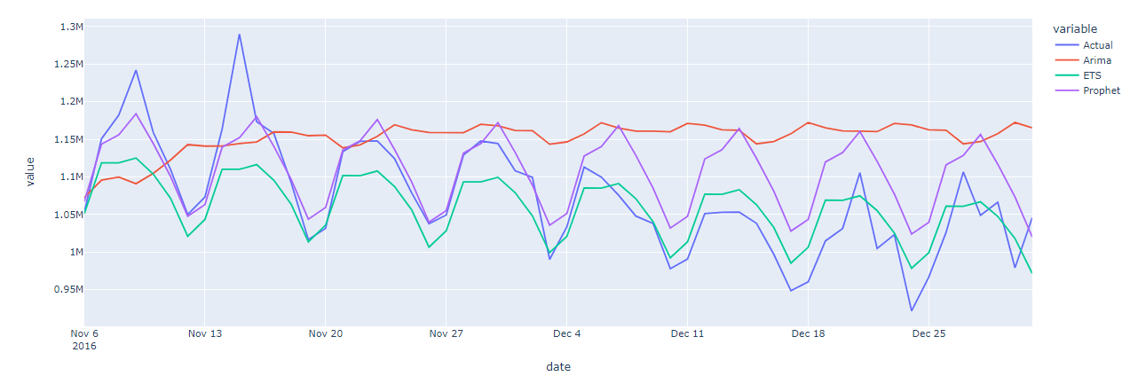
MODEL COMPARISON
MAPE
ARIMA – 9.44
ETS – 5.29
FB Prophet – 4.39

Slide 16
CHALLENGES
Arima was such a pain
Time series data related things were not included in our course
FB Prophet nan values during prediction due to its indexing
Making the data stationary
Faced hard time making plotly plots
While training models, came to know that most of the things I did in EDA are useless

Slide 17
THANK YOU
Email: ridajawad999@gmail.com
Phone: +243 828 767 761

